Slide 1
Presentation #02
Guidelines

Slide 2
From the Syllabus
Presentation #2 is a “Project Proposal for a corporate review committee. This proposal will restate your executive summary (which may be altered based on management feedback) and will also include a detailed feasibility analysis matrix with a minimum of 3 candidates. It will also include possible databases, sample inputs, sample outputs and any models for the information technology solution he / she chose to solve the business problem you selected earlier”
Notes:
This presentation is a follow on to presentation #1. The set of requirements you presented were the primary input to the design phase and you are presenting the 3 final design options you evaluated, reviewing with the committee how you made your final choice, presenting the benefits your solution will provide and finally requesting funding based on the return your system will provide.

Slide 3
From the Syllabus
This presentation & paper must include:
“Each presentation should take no less than forty (40) minutes and no more than sixty (60) minutes plus be prepared for 10 minutes of questions and discussion.”
“The specific hardware & software being evaluated / chosen”
“A detained feasibility analysis”
“A completed candidate matrix and articulation of a scoring / weighting rationale that ties back to the requirement you provided in your first presentation”
Notes:
I will go over with you a sample feasibility analysis & candidate matrix that you can use as a model for your presentation.

Slide 4
From the Syllabus
This presentation & paper must include:
“Reasonably estimated costs of the solution you selected”
“A substantive ROI analysis that incorporates the time value of money, estimated prices, cost / benefits analysis and the reasons for selecting the proposed system to be built / purchased”
Notes:
I will also review the financial justification options you can use.

Slide 5
From the Syllabus
This presentation & paper must include:
“A complete disclosure of all benefits with a detailed description of how they were monetized. Specifically all cost reductions (i.e. staff reductions, increased productivity, more accuracy, etc.) must be explained thoroughly as well as all revenue increases (i.e. better decision making, increased customer loyalty, staff redeployment, more sales time, etc.)”
In addition, the paper will explain why the proposed system favorably competes for funding among the other alternatives that exist in your organization
Notes:
Any Questions on what is required?

Slide 6
Candidate Systems Matrix
 | Candidate 1 Name | Candidate 2 Name | Candidate 3 Name
Stakeholders
Knowledge
Processes
Communications
Candidate Systems Matrix – a tool used to document similarities and differences between candidate systems.
Stakeholders - how system will interact with people and other systems.
Knowledge - how data will be implemented, how inputs will be captured, how outputs will be generated.
Processes - how processes will be built and implemented.
Communications - how processes and data will be distributed.
Notes:
During the decision analysis phase of the systems analysis, the analyst identifies candidate system solutions and then analyzes them for feasibility. We talked about criteria and techniques. Now we will talk about documentation techniques.
What are good characteristics of documentation techniques?
Is there a role for our existing system in this task?
What are some of the things we focus on in each row?

Slide 7
Sample Candidate Systems Matrix
Characteristics | Candidate 1 | Candidate 2 | Candidate 3
Portion of System Computerized Brief description of that portion of the system that would be computerized in this candidate. | COTS package Platinum Plus from Entertainment Software Solutions would be purchased and customized to satisfy Member Services required functionality. | Member Services and warehouse operations in relation to order fulfillment. | Same as candidate 2.
Benefits Brief description of the business benefits that would be realized for this candidate. | This solution can be implemented quickly because it’s a purchased solution. | Fully supports user required business processes for SoundStage Inc. Plus more efficient interaction with member accounts. | Same as candidate 2.
Servers and Workstations A description of the servers and workstations needed to support this candidate. | Technically architecture dictates Pentium III, MS Windows 2000 class servers and workstations (clients). | Same as candidate 1. | Same as candidate 1.
Software Tools Needed Software tools needed to design and build the candidate (e.g., database management system, emulators, operating systems, languages, etc.). Not generally applicable if applications software packages are to be purchased. | MS Visual C++ and MS Access for customization of package to provide report writing and integration. | MS Visual Basic 5.0 System Architect 2001 Internet Explorer | MS Visual Basic 5.0 System Architect 2001 Internet Explorer
Notes:
The cells in this matrix help the reader understand the differences between the options.
What are some of the more dramatic differences?

Slide 8
Sample Candidate Systems Matrix (cont.)
Characteristics | Candidate 1 | Candidate 2 | Candidate 3
Application Software A description of the software to be purchased, built, accessed, or some combination of these techniques. | Package solution | Custom Solution | Same as candidate 2.
Method of Data Processing Generally some combination of: on-line, batch, deferred batch, remote batch, and real-time. | Client/Server | Same as candidate 1. | Same as candidate 1.
Output Devices and Implications A description of output devices that would be used, special output requirements, (e.g., network, preprinted forms, etc.), and output considerations (e.g., timing constratints) | (2) HP4MV department laser printers (2) HP5SI LAN laser printers | (2) HP4MV department laser printers. (2) HP5SI LAN laser printers (1) PRINTRONIX bar-code printer (includes software & drivers) Web pages must be designed to VGA resolution. All internal screens will be designed for SVGA resolution. | Same as candidate 2.
Notes:
We must make sure our matrix considers all our constraints.
How may a constraint impact our technology choice?

Slide 9
Sample Candidate Systems Matrix (cont.)
Characteristics | Candidate 1 | Candidate 2 | Candidate 3
Input devices and Implications A description of input methods to be used, input devices (e.g., keyboard, mouse, etc.), special input requirements (e.g., new or revised forms from which data would be input), and input considerations (e.g., timing of actual inputs). | Keyboard & mouse. | Apple “Quick Take” digital camera and software (15) PSC Quickscan laser bar-code scanners (1) HP Scanjet 4C Flatbed Scanner Keyboard and mouse | Same as candidate 2.
Storage Devices and Implications Brief description of what data would be stored, what data would be accessed from existing stores, what storage media would be used, how much storage capacity would be needed, and how data would be organized. | MS SQL Server DBMS with 1000GB arrayed capability. | Same as candidate 1. | Same as candidate 1.
Notes:
How do we obtain our candidates?

Slide 10
Feasibility Analysis
Feasibility – the measure of how beneficial or practical an information system will be to an organization.
Feasibility analysis – the process by which feasibility is measured.
Creeping Commitment – an approach to feasibility that proposes that feasibility should be measured throughout the life cycle.
Notes:
A major ingredient in the systems analyst’s recipe for information technology projects are comprehensive proposals. Are proposals usually written?
What do good proposal always include?
How does feasibility relate to ROI?

Slide 11
Six Tests For Feasibility
Operational feasibility – a measure of how well a solution meets the system requirements.
Technical feasibility – a measure of the practicality of a technical solution and the availability of technical resources and expertise.
Schedule feasibility – a measure of how reasonable the project timetable is.
Economic feasibility - a measure of the cost-effectiveness of a project or solution.
Notes:
Feasibility can be categorized into four major groups.
Technical feasibility is computer oriented. What questions do we ask to determine technical feasibility?
Schedule feasibility is time oriented. What questions do we ask to determine schedule feasibility?
All the candidate solutions should be analyzed according to all of the above criteria. Will any candidate be “most feasible” according to all of the criteria?

Slide 12
Feasibility Analysis Matrix
Feasibility Analysis Matrix – a tool used to rank candidate systems.
 | Weighting | Candidate 1 | Candidate 2 | Candidate 3
Description
Operational Feasibility
Cultural Feasibility
Technical Feasibility
Schedule Feasibility
Economic Feasibility
Legal Feasibility
Ranking
Notes:
A complementary documentation technique to the candidate systems matrix is the Feasibility Analysis Matrix.
What do we do to rank our candidate using this matrix?
What do we do next?

Slide 13
Sample Feasibility Analysis Matrix
Feasibility Criteria
Operational Feasibility
Functionality. A description of to what degree the candidate would benefit the organization and how well the system would work.
Political. A description of how well received this solution would be from both user management, user, and organization perspective.
Technical Feaasibility
Technology. An assessment of the maturity, availability (or ability to acquire), and desirability of the computer technology needed to support this candidate.
Expertise. An assessment of the technical expertise needed to develop, operate, and maintain the candidate system.
Economic Feasibility
Cost to develop:
Payback period (discounted):
Net present value:
Detailed calculations:
Schedule Feasibility
An assessment of how long the solution will take to design and implement.
Ranking
Wt.
30%
30%
30%
10%
100%
Candidate 1
Only supports Member Services requirements and current business processes would have to be modified to take advantage of software functionality.
Score: 60
Current production release of Platinum Plus package is version 1.0 and has only been on the market for 6 weeks. Maturity of product is a risk and company charges an additional monthly fee for technical support.
Required to hire or train C++ expertise to perform modifications for integration requirements.
Score: 50
Approximately $350,000.
Approximately 4.5 years.
Approximately $210,000.
See Attachment A.
Score: 60
Less than 3 months.
Score: 95
60.5
Candidate 2
Fully supports user required functionality.
Score: 100
Although current technical staff has only Powerbuilder experience, the senior analysts who saw the MS Visual Basic demonstration and presentation have agreed the transition will be simple and finding experienced VB programmers will be easier than finding Powerbuilder programmers and at a much cheaper cost.
MS Visual Basic is a mature technology based on version number.
Score: 95
Approximately $418,040.
Approximately 3.5 years.
Approximately $306,748.
See Attachment A.
Score: 85
9-12 months.
Score: 80
92
Candidate 3
Same as candidate 2.
Score: 100
Although current technical staff is comfortable with Powerbuilder, management is concerned with recent acquisition of Powerbuilder by Sybase Inc. MS SQL Server is a current company standard and competes with SYBASE in the client/server DBMS market. Because of this we have no guarantee future versions of Powerbuilder will “play well” with out current SQL Server.
Score: 60
Approximately $400.000.
Approximately 3.3 years.
Approximately $325,500.
See Attachment A.
Score: 90
9-12 months.
Score: 85
85
Notes:
We score each group and assess a weight.
What are the benefits of quantifying the relative merits of each candidate?

Slide 14
Cost-Benefit Analysis Techniques
Costs:
Development costs are one time costs that will not recur after the project has been completed.
Operating costs are costs that tend to recur throughout the lifetime of the system. Such costs can be classified as:
Fixed costs — occur at regular intervals but at relatively fixed rates.
Variable costs — occur in proportion to some usage factor.
Benefits:
Tangible benefits are those that can be easily quantified.
Intangible benefits are those benefits believed to be difficult or impossible to quantify.
Notes:
How do we determine economic feasibility?
What can we say about benefits in general?
Who can give me some examples of tangible benefits?
Who can give me some examples of intangible benefits?

Slide 15
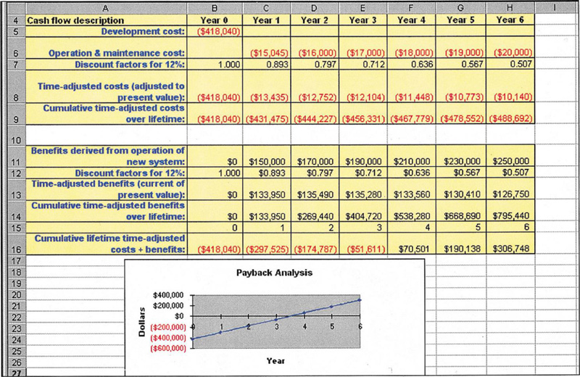
Payback Analysis for a Project
Notes:
What is the total cost for this project?
What interest rate do I use to determine the current value of future money (costs or benefits)?
What is the benefits derived?
What is the time adjusted costs of the benefits derived?
What is the payback period?
What is the relationship between costs & benefits at 3 years & 6 months?

Slide 16
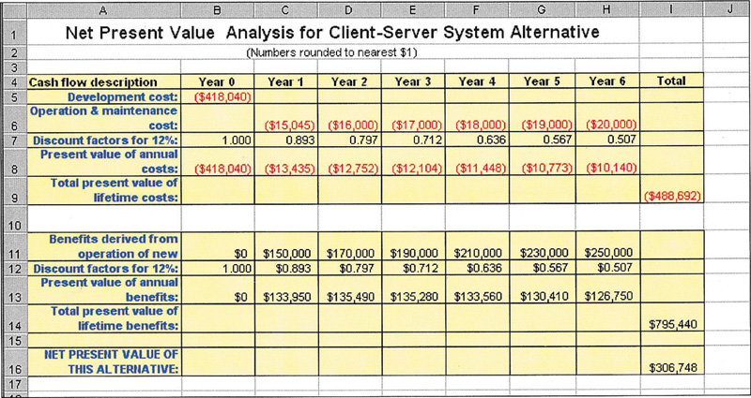
Net Present Value (NPV) Analysis
Net present value – analysis technique that compares annual discounted costs and benefits of alternative solutions.
Notes:
The top part of this spread sheet (Rows 5-13) are exactly the same as our prior example. What did we do with these rows?
How do we translate this example?

Slide 17
Return-on-Investment Analysis (ROI)
Return-on-Investment (ROI) analysis – a technique that compares the lifetime profitability of alternative solutions.
The ROI for a solution or project is a percentage rate that measures the relationship between the amount the business gets back from an investment and the amount invested.
Lifetime ROI = (estimated lifetime benefits – estimated lifetime costs) / estimated lifetime costs
Annual ROI = lifetime ROI / lifetime of the system
Notes:
A second technique to assess economic feasibility is ROI. What metric to we use for ROI?
Once again, lifetimes might have a maximum duration per company policy and all costs & benefits must be time adjusted. Using our prior example, what is this project’s life time ROI?
What is its annual ROI?
What value does annual ROI have?
What happens if we do not adjust costs?

Slide 18
Formats for Written Reports
factual format - traditional and best suited to readers interested in facts and details as well as conclusions.
administrative format - modern, result-oriented format preferred by managers and executives.
Factual Format | Administrative Format
I. Introduction | I. Introduction
II. Methods and procedures | II. Conclusions and recommendations
III. Facts and details | III. Summary and discussion of facts and details
IV. Discussion and analysis of facts and details | IV. Methods and procedures
V. Recommendations | V. Final conclusion
VI. Conclusion | VI. Appendixes with facts and details
Notes:
Our next step is proposing a system to users and management.
Should it be written or oral?
How long should it be?
Contrast factual and administrative format.

Slide 19
System Proposal – formal presentations
Formal presentation – a special meeting used to sell new ideas and gain approval for new systems. They may also be used for any of these purposes:
Sell new system
Sell new ideas
Head off criticism
Address concerns
Verify conclusions
Clarify facts
Report progress
Notes:
An SA is usually required to propose his/her system orally either in addition to or instead of a written report. What are the things that make oral presentations effective?
What are the advantages of oral presentations?
What are the disadvantages of oral presentations?

Slide 20
Typical Outline and Time Allocation for an Oral Presentation
I. Introduction (one-sixth of total time available)
A. Problem statement
B. Work completed to date
II. Part of the presentation (two-thirds of total time available)
A. Summary of existing problems and limitations
B. Summary description of the proposed system
C. Feasibility analysis
D. Proposed schedule to complete project
III. Questions and concerns from the audience (time here is not to be included in the time allotted for presentation and conclusion; it is determined by those asking the questions and voicing their concerns)
IV. Conclusion (one-sixth of total time available)
A. Summary of proposal
B. Call to action (request for whatever authority you require to continue systems development)
Notes:
What should you worry about when it comes to oral presentations?

Slide 21
Conducting the Formal Presentation
Dress professionally.
Avoid using the "I" word when making the presentation.
Maintain eye contact with the group and keep an air of confidence.
Be aware of your own mannerisms.
Notes:
Does it make sense to practice your presentation beforehand in front of an audience?
What does avoiding the “I” word do?
What are some distracting mannerisms?

Slide 22
When Answering Questions
Always answer a question seriously, even if you think it is a silly question.
Answer both the individual who asked the question and the entire audience.
Summarize your answers.
Limit the amount of time you spend answering any one question.
Be honest.
Notes:
What do you do if someone in your audience is not listening?
Do presentations leave a lasting impression?

Slide 23
Chapter 6: Behavioral Modeling

Slide 24
Learning Objectives
Understand the rules and style guidelines for sequence and communication diagrams and behavioral state machines.
Understand the processes used to create sequence and communication diagrams, behavioral state machines and CRUDE matrices.
Be able to create sequence and communication diagrams, behavioral state machines and CRUDE matrices.
Understand the relationship between the behavioral models and the structural and functional models.

Slide 25
Introduction
Behavioral models describe the internal behavior of a system
Behavioral model types:
Representations of the details of a business process identified by use-cases
Interaction diagrams (Sequence & Communication)
Shows how objects collaborate to provide the functionality defined in the use cases.
Representations of changes in the data
Behavioral state machines
Notes:
What does behavioral modeling focus on?

Slide 26
Behavioral Models
Analysts view the problem as a set of use cases supported by a set of collaborating objects
Aids in organizing and defining the software
Behavioral models depict this view of the business processes:
How the objects interact and form a collaboration to support the use cases
An internal view of the business process described by a use case
Creating behavioral models is an iterative process which may induce changes in other models
Notes:
How is behavioral modeling related to structural modeling?
Why is iteration important when creating a behavioral model?

Slide 27
Sequence Diagrams
Illustrate the objects that participate in a single use-case
A dynamic model
Shows the sequence of messages that pass between objects
Aid in understanding real-time specifications and complex use-cases
Generic diagram shows all scenarios for a use-case
Instance diagrams show a single scenario
Notes:
There are two types of UML interaction diagrams Sequence Diagrams & Communication diagrams. How are them similar?
How do they differ?
How does a use case relate to these interaction diagrams?

Slide 28
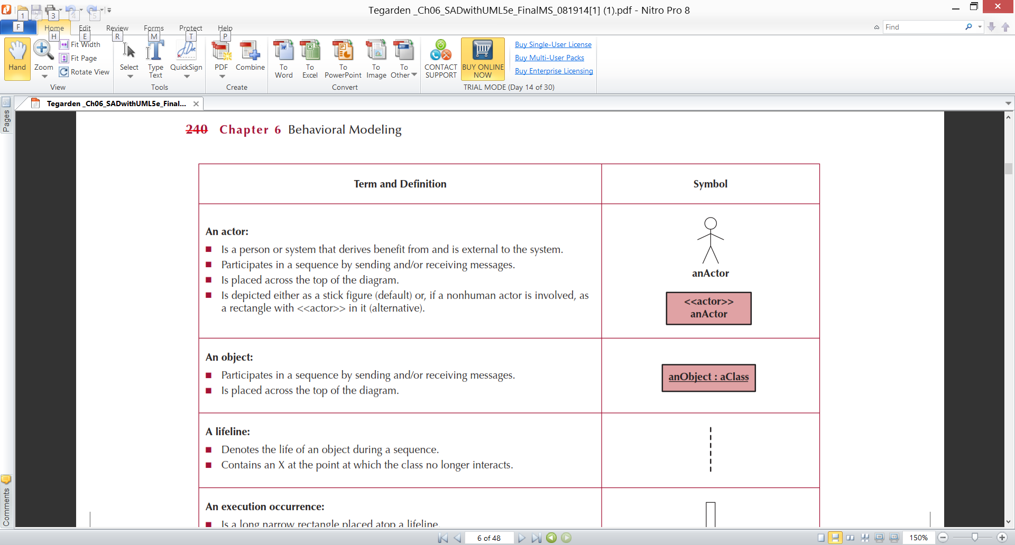
Sequence Diagram Syntax
Notes:
How does a use case relate to a sequence diagram?

Slide 29
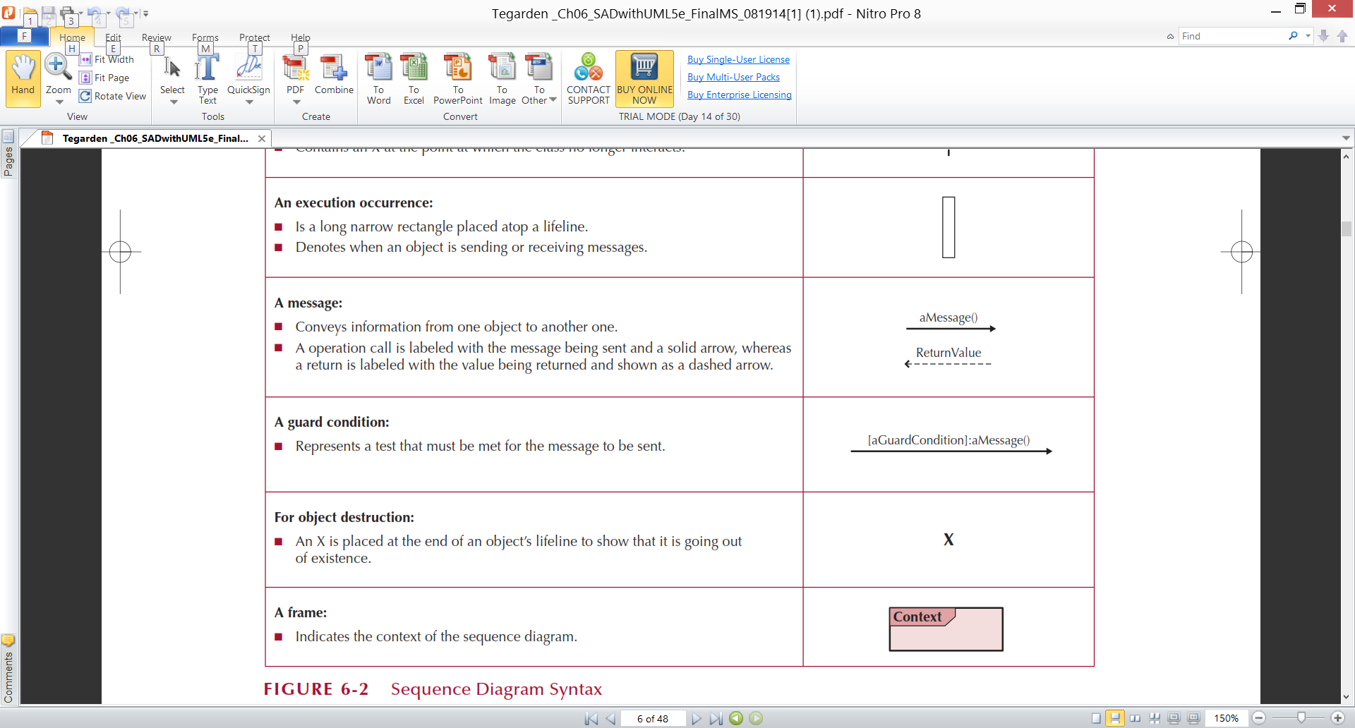
More Sequence Diagram Syntax
Notes:
What is an operational call message and how is it depicted on this slide?
What is a return message and how is it depicted on this slide ?

Slide 30
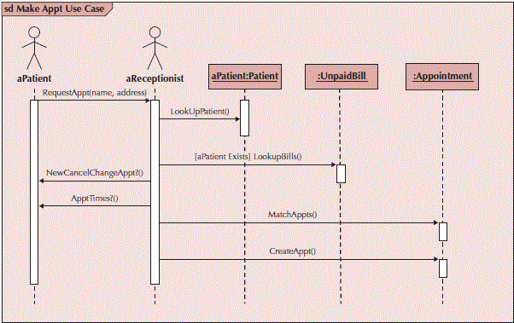
Sample Sequence Diagram
Notes:
What are the stick figures?
What are the larger rectangles?
What are the thin rectangles?
What are the thin lines?
What role do the arrows play?
What is in the upper right hand corner?

Slide 31
Sample Sequence Diagram
Notes:
What are the vertical thin lines?
If a shopping cart is used for capturing line items for an order, how do you depict its lifeline once the order is confirmed?
When drawing a sequence diagram, what guidelines should you follow?

Slide 32
Building Sequence Diagrams
Set the context
Identify actors and objects that interact in the use-case scenario
Set the lifeline for each object
Add messages by drawing arrows
Shows how they are passed from one object to another
Include any parameters in parentheses
Obvious return values are excluded
Add execution occurrence to each object’s lifeline
Validate the sequence diagram
Ensures that it depicts all of the steps in the process
Notes:
Are there any guidelines for depicting messages?
Do messages have names?

Slide 33
Communication Diagrams
Depict the dependencies among the objects
An object diagram that shows message passing relationships
Emphasize the flow through a set of objects
Notes:
How does a use case relate to a communication diagram?
Are there guidelines to follow when drawing a communication diagram?

Slide 34
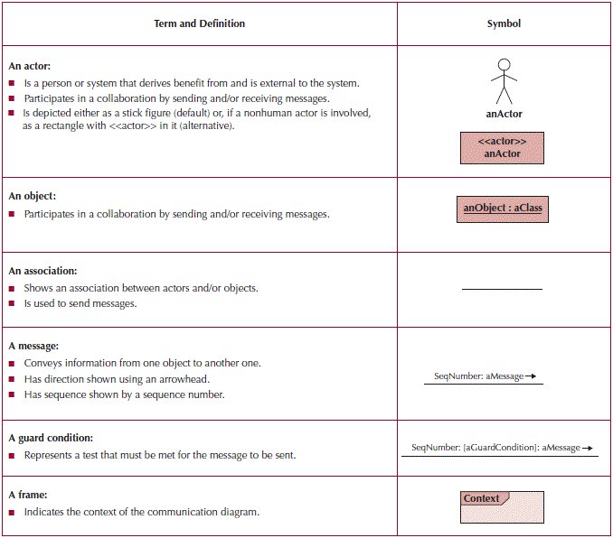
Communication Diagram Syntax
Notes:
How do you depict Important sequencing on a communication diagram?

Slide 35
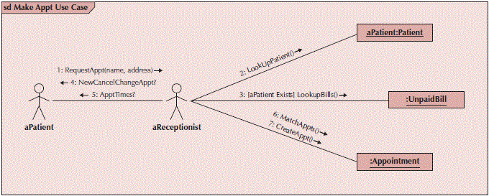
Sample Communication Diagram
Notes:
What are the stick figures?
What are the larger rectangles?
What are the solid lines without arrows?
What are the source documents that can be used to develop a Communication Diagram?
How do you show the sequence of messages on a communication diagram?
How do you show the direction of a message on a communication diagram?
How do use cases relate to a sequence and communication diagrams?

Slide 36
Sample Communication Diagram
Notes:
How do you show the sequence of messages on a communication diagram?
How do you show the direction of a message on a communication diagram?
How do use cases relate to a sequence and communication diagrams?

Slide 37
Building Communication Diagrams
Set the context
Identify objects, actors and associations between them
Lay out the diagram
Add the messages
Validate the model
Notes:
What role do aggregation & generalization play in a communications diagram?

Slide 38
How do you show that a temporary object is to go out of existence on a sequence diagram?

Slide 39
If a shopping cart is used for capturing line items for an order, how do you depict its lifeline on a Sequence Diagram once the order is confirmed?

Slide 40
What are the source documents that can be used to develop a Communication Diagram?

Slide 41
How do you show the sequence of messages on a communication diagram

Slide 42
How do use cases relate to a sequence and communication diagrams?

Slide 43
Which of the following objects would be most likely to be destroyed at some point in time in a sequence diagram?
a. customer
b. order
c. order item
d. invoice
e. shopping cart

Slide 44
When an object sends a message to itself in a sequence diagram, that is referred to as _____.
a. recursive-messaging
b. self-messaging
c. self-delegation
d. recursive-delegation
e. none of these

Slide 45
A sequence diagram can only be drawn to represent a single scenario in a use case.
T / F ?

Slide 46
It is possible for an object to create another object, resulting in the message going directly to the object, not its lifeline.
T / F ?

Slide 47
Both the communication diagram and the sequence diagram can show return messages.
T / F ?

Slide 48
The communication diagram is used for modeling process flow.
T / F ?

Slide 49
Behavioral State Machines
Objects may change state in response to an event
Different states are captured in this model
Shows the different states through which a single object passes during its life
May include the object’s responses and actions
Example: patient states
New patient—has not yet been seen
Current patient—is now receiving treatment
Former patient—no longer being seen or treated
Typically used only for complex objects
Notes:
How is “state” related to “behavior”?
How are “classes”” related to “objects”?
How are “Objects” related to “behaviors”?
How are “actions” related to “activities”?
Describe the type of class that is best represented by a behavioral state machine.
Give an example of classes that would be good candidates for behavioral state machine.

Slide 50
Components of State Machines
States—values of an object’s attributes at a point in time
Events—the cause of the change in values of the object’s attributes
Transitions—movement of an object from one state to another
May include a guard condition to flag that a condition is true and allow the transition
Notes:
Do events lead to state transitions on a behavioral state machine diagram?
What is a use case ( a scenario) that would require a state machine diagram?

Slide 51
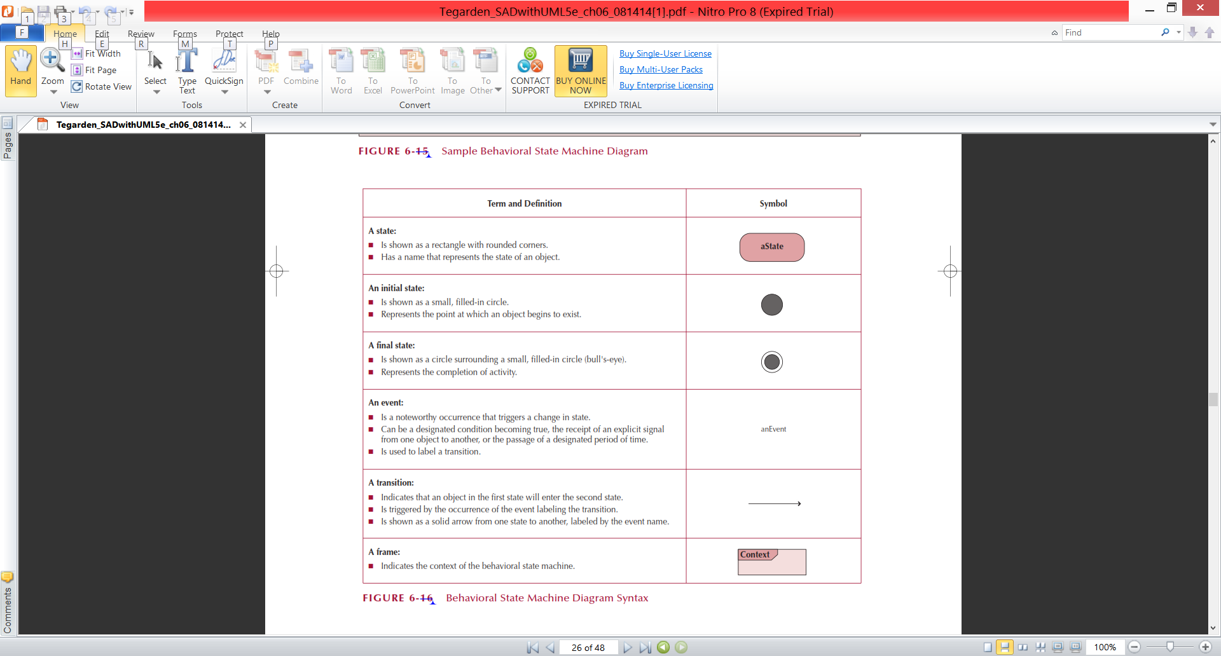
State Machine Syntax
Notes:
Are all states always depicted using rounded rectangles on a behavioral state machine? No the initial state is represented with a filled in circle and the final state with a "bulls eye" circle.

Slide 52
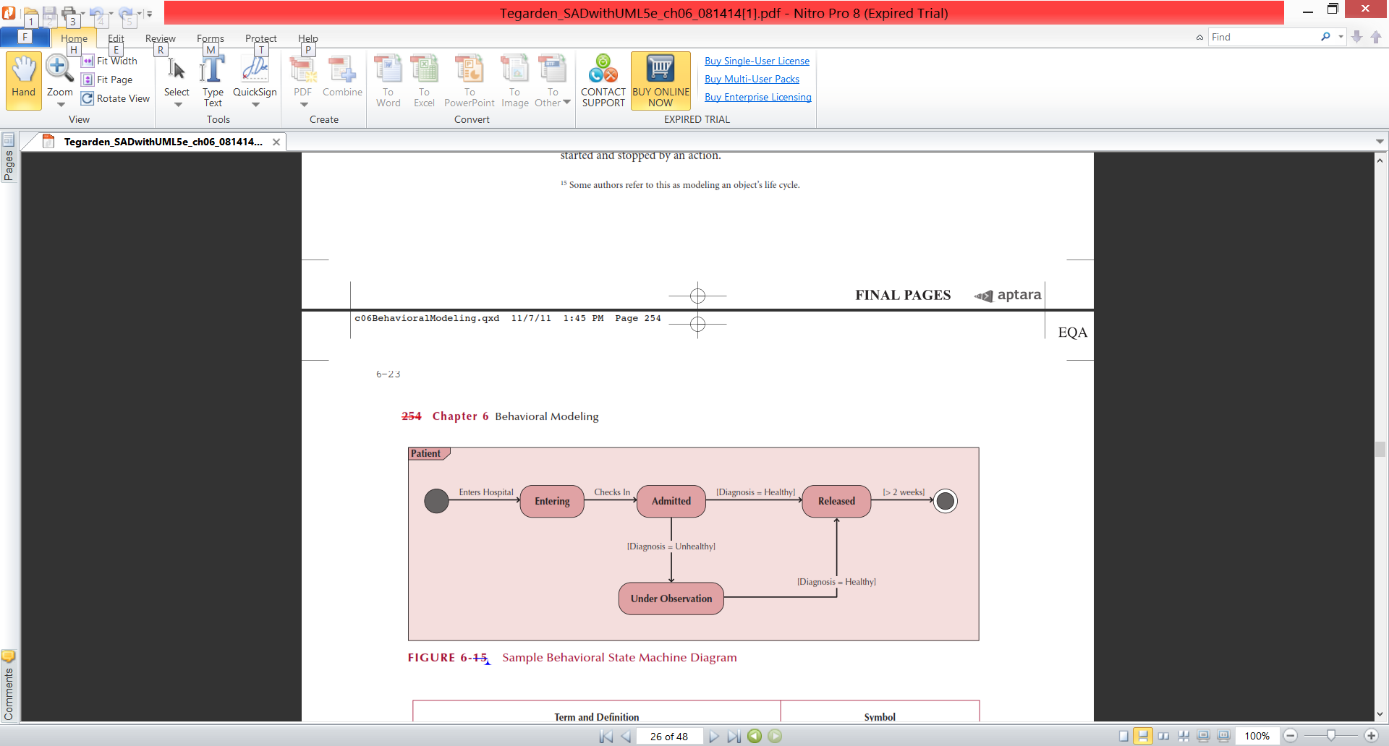
Sample State Machine
Notes:
What is an Object State?
Are states always depicted using rounded rectangles on a behavioral state machine?
What is a state transition event?
How are guard conditions shown on a behavioral state machine?

Slide 53
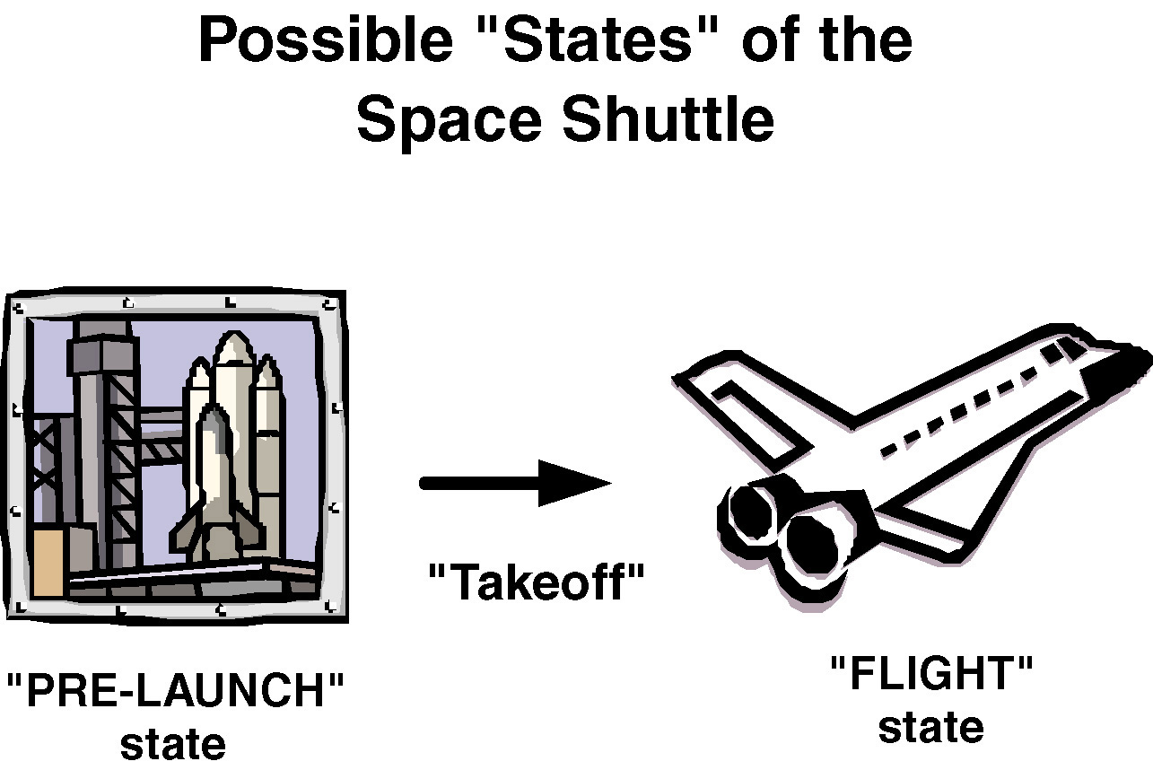
Object State Example
Notes:
What is the initial state?
What is the final state?
What is he transition event?

Slide 54
Building a Behavioral State Machine
Set the context
Identify the states of the object
Initial
Final
Stable states during its lifetime
Lay out the diagram—use a left to right sequence
Add the transitions
Identify the triggers (events that cause the transition)
Identify the actions which execute
Identify the guard conditions
Validate the model—ensure all states are reachable
Notes:
When drawing a behavioral state machine, what guidelines should you follow?
When do you have a "black hole" state?
When do you have a "miracle" state?

Slide 55
Why is iteration important when creating a behavioral model?

Slide 56
How is behavioral modeling related to structural modeling?

Slide 57
How does an object’s “state” related to its “behavior”?

Slide 58
Do events lead to state transitions on a behavioral state machine diagram?

Slide 59
How are “actions” related to “activities”?

Slide 60
When do you have a "black hole" state?

Slide 61
When do you have a "miracle" state?

Slide 62
What does behavioral modeling focus on?

Slide 63
What is an Object State?

Slide 64
What is a state transition event?

Slide 65
CRUDE Analysis
Helps to identify object collaborations
Labels object interaction in 5 possible ways:
Create—can one object create another?
Read—can one object read the attributes of another?
Update—can one object change values in another?
Delete—can one object delete another object?
Execute—can one object execute the operations of another?
Utilizes a matrix to represent objects and their interactions
Most useful as a system-wide representation
Notes:
What is CRUD analysis and what is it used for?
What are the labels used is a CRUD matrix?

Slide 66
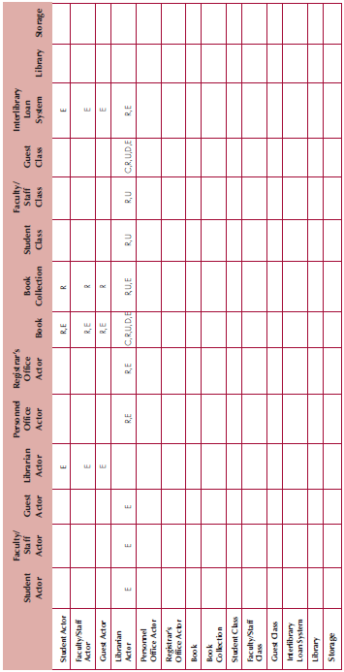
Sample CRUDE Matrix
Notes:
What do the letters in the cells tell us? The type of interaction between the columns & rows: C for create, R for read or reference, U for update, and D for delete.
What does a data to location – CRUD (create, read, update, delete) matrix do? It lets us deal with business operating locations, what data we provide and what kind of access rights we provide. Note each cell documents the level of access.
How does a data-to-location-CRUD matrix supplement a data requirements? While a logical data model is effective for describing what data is to be stored for a new system, it does not communicate those requirements on a business operating location basis. The data-to-location-CRUD matrix can supplement the data model by identifying what data and access rights are needed at which locations.

Slide 67
Verifying & Validating Behavioral Models
Actors must be consistent between models
Messages on sequence diagrams must match associations on communication diagrams
Guard conditions on a sequence diagram must appear on a communication diagram
Sequence of messages must correspond to the top down ordering of messages being sent
State transitions must be associated with a message on a sequence diagram
Entries in a CRUDE matrix imply messages being sent
Notes:
How do messages on a sequence diagram relate to messages on a communication diagram?
What is role playing?
Describe how role playing is conducted?
What value does role playing have?

Slide 68
How does a data-to-location-CRUD matrix supplement a data requirements?

Slide 69
A data-to-location CRUD matrix is a table in which garbage values that fall outside the domain of an attribute are identified and used for data verification.
T / F ?

Slide 70
What is role playing?

Slide 71
Describe how role playing is conducted?

Slide 72
What value does role playing have?

Slide 73
The external behavior of a system is described by _____.
a. functional models
b. structural models
c. behavioral models
d. interaction diagrams
e. statechart diagrams

Slide 74
_____ are information that is sent to objects to tell it to execute one of its behaviors.
a. attributes
b. operations
c. messages
d. instances
e. use-cases

Slide 75
A set of rules are used for performing the verification and validation walkthrough of behavioral model. One of the rules is: all _______________ contained in a behavior state machine must be associated with a message being sent on a sequence and communication diagram, and it must be classified as a (C)reate, (U)pdate, or (D)elete message in a CRUDE matrix.
a. messages
b. behaviors
c. transitions
d. associations
e. dependences

Slide 76
Only create behavioral state machine for “complex” objects.
T / F ?

Slide 77
What is a sequence diagram used for? Why would an analyst choose a sequence diagram over a communication diagram?

Slide 78
What does the acronym CRUD stand for? Why would an analyst create a CRUD matrix during his analysis?

Slide 79
Think of an employee object. What are several of the possible states that that object may have over time? Which of these states would be the initial state? Which would be the final state?

Slide 80
Explain the term transition.

Slide 81
Explain the terms event, action and activity.

Slide 82
Student Bookstore at Pleasant Creek Community College
Read Student Bookstore at Pleasant Creek Community College
(Class Handout)

Slide 83
Student Bookstore at Pleasant Creek Community College
List possible objects in the bookstore operation, including their attributes and methods.
Identify possible use cases and actors.
Create an object relationship diagram that provides an overview of the system, including how textbooks are selected by instructors, approved by a department head, and sold to students by the bookstore

Slide 84
Student Bookstore at Pleasant Creek Community College
List possible objects in the bookstore operation

Slide 85
Student Bookstore at Pleasant Creek Community College
List possible objects in the bookstore operation, including their attributes and methods.

Slide 86
Student Bookstore at Pleasant Creek Community College
Identify possible use cases and actors.

Slide 87
Student Bookstore at Pleasant Creek Community College
Create an object relationship diagram that provides an overview of the system, including how textbooks are selected by instructors, approved by a department head, and sold to students by the bookstore

